Slide 1
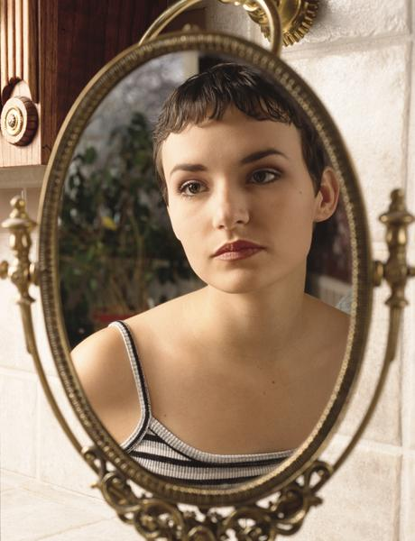

MIRROR
~By Sylvia Plath

Slide 2

ABOUT THE AUTHOR
Sylvia Plath(1932-1963) was an American poet, novelist and short story writer.
She was an excellent writer but suffered from prolong depression. She even made unsuccessful suicide attempts.
In 1963, she published a semi-autobiographical novel, The Bell Jar, under the pseudonym Victoria Lucas.
On February 11, 1963, during one of the worst English winters on record, Plath wrote a note to her downstairs neighbour instructing him to call the doctor, then she committed suicide using her gas oven.

Slide 3

ABOUT THE POEM
In the poem, Sylvia Plath talks about the mirror’s exactness, truthfulness and human beings’ relationship with it for years together.
The mirror is unprejudiced, not misted, has no preconceptions and reflects back an object exactly as it is.
Plath talks about a woman who, in the mirror, sees herself grow old day by day. Naturally, she loses her youth and her beauty for which she blames the mirror. However, regardless of her appearance she remains the same at heart.
This poem highlights the unbiased characteristic of a mirror which tells us that it is not the external beauty that matters as much as the inside of a person.

Slide 4
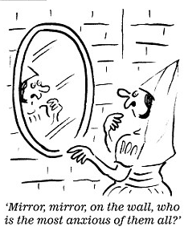
THEME
The poem deals with the state of anxiety when one starts growing up and showing signs of ageing.
No one wants to age and look old but that’s the law of nature.
Hence, we need to develop an inner strength to face all stages of life gracefully.

Slide 5
STANZA 1
I am silver and exact. I have no preconceptions.
Whatever I see I swallow immediately
Just as it is, unmisted by love or dislike.
I am not cruel, only truthful-
Giving the description of itself, the mirror says that it is silver coloured and accurate while reflecting the images of the objects that fall on its surface. The image is clear and exact as it is neither distorted nor beautified according to its likes and dislikes. It is not out of cruelty but truthfulness that it reflects exactly as it sees with a thoughtless mind.

Slide 6
STANZA 2
The eye of a little god, four-cornered.
Most of the time mediate on the wall on the opposite wall.
It’s pink with speckles. I have looked at it so long
I think it is a part of my heart. But it flickers.
Face and darkness separate us over and over.
The mirror refers to itself as God because it has seen every side of a person from every nook and corner. Most of the time, it reflects the opposite wall which is pink in colour and has dark patches on it. It had looked at it for such a long time that it seems to a part of its very existence now. However, the steady view is interrupted at times by darkness and people who want to see themselves in the mirror.

Slide 7
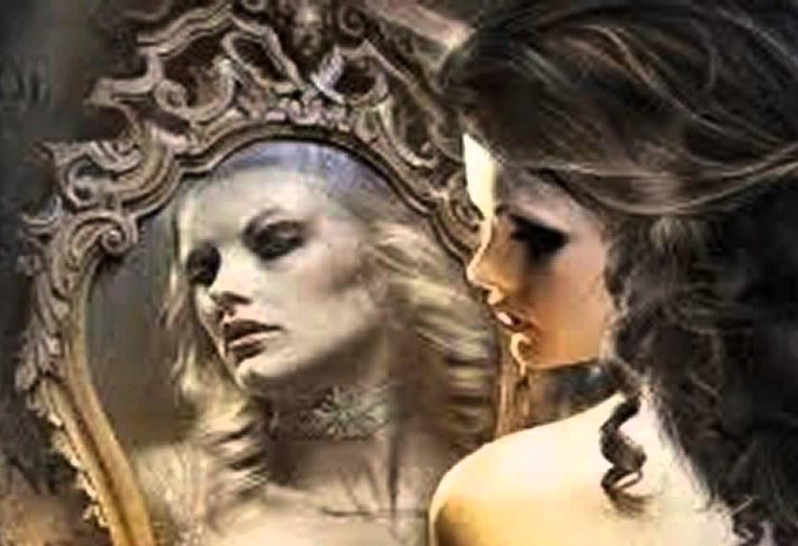
STANZA 3
Now I am a lake. A woman bends over me,
Searching my reaches for what she really is.
Then she turns to those liars, the candles or the moon.
I see her back, and reflect it faithfully.
She rewards me with tears and an agitation of hands.
The surface of a still lake can act as a mirror. Hence, although the narrator’s form has changed, its function hasn’t. It is still a reflecting surface. A woman looks into it very closely. Delving into its depth, she searches for her lost beauty and youth. Candlelight and moonlight can often hide the imperfections in one’s face. They are thus not accurate or truthful. Hence the mirror calls them liars. But even though, the lake performs its duty as a mirror, the woman is not pleased with what she sees. She feels sad and angry, thus leading to ‘tears and an agitation of hands’.

Slide 8
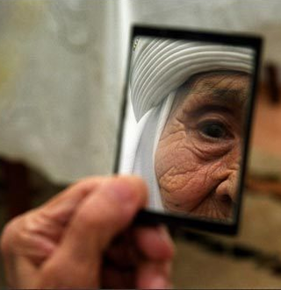
STANZA 4
I am important to her. She comes and goes.
Each morning it is her face that replaces the darkness.
In me she has drowned a young girl, and in me an old woman
Rises toward her day after day like a terrible fish.
A fish that is at a great depth will appear indistinct and far away, almost unreal. However as it slowly starts to swim upwards it will gradually appear closer and more and more discernible. Similarly, when one is young, old age seems distant and vague. However, as one grows older, old age slowly comes closer and becomes more and more evident. Sylvia Plath has thus used a powerful simile here.
The word ‘terrible’ used before the fish is probably because the woman fears old age and its associated challenges, and thus the rising fish is ‘terrible’.

Slide 9

MESSAGE
It tells us that the external appearance does not matter. What matters is, who we are inside.
It tell us to value our true friends, even if they sometimes tell us things we don’t want to hear. It’s better than going to those liars like the candles or the moon.
The poem conveys the message that rather than living in the world of illusions, we need to change our attitude and learn to face and accept reality without indulging in self-pity.

